Slide 1
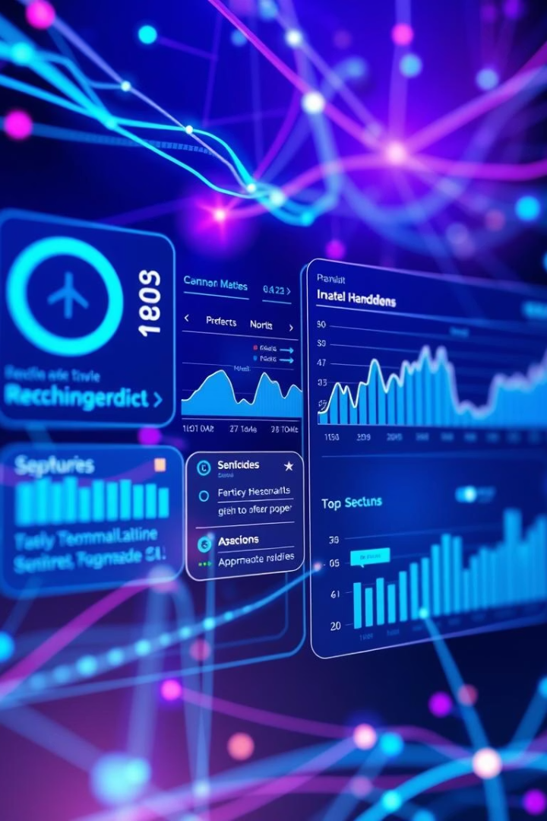

Tourism Experience Analytics
Welcome to our presentation on Tourism Experience Analytics. We will explore how data science transforms travel, focusing on classification, prediction, and recommendation systems.
by Aishwarya S

Slide 2
Project Overview
Domain
Key Focus
Main Tasks
Tourism and personalized travel experiences.
Data-driven personalized travel experiences.
Predict attraction ratings (Regression).
Predict visit modes (Classification).
Recommend attractions (Recommendation System).

Slide 3





Business Use Cases
Personalized Suggestions
Offer tailored travel recommendations.
Customer Segmentation
Understand and predict customer behavior.
Boost Engagement
Increase user interaction via targeted recommendations.
Trend Insights
Gain data-driven insights into tourism trends.

Slide 4

Dataset Overview
Transaction Data
User Data
Ratings, Visit Year, Month, Visit Mode.
Location: Continent, Region, Country, City.
Attraction Data
Type, Location, Popularity.

Slide 5





Data Preprocessing & Cleaning
Handle Missing Values
Cleaned and imputed missing data points.
Merge Datasets
Combined using UserId and AttractionId.
Encode Variables
Converted categorical features to numerical.
Scale Numerical Data
Normalized data for model input efficiency.

Slide 6

Exploratory Data Analysis
User Distributions
Geographic spread of users by location.
Attraction Popularity
Identified top-rated and most visited attractions.
Visit Mode & Location
Correlation between visit mode and geographic origin.
Ratings by Attraction Type
Average ratings for different attraction categories.
Exploratory Data Analysis revealed key patterns and relationships within the tourism dataset, informing subsequent modeling decisions.

Slide 7

Model 1 – Regression
Goal
Predict attraction ratings accurately.
Algorithm
XGBoost for high prediction accuracy.
Features
User location, visit time, attraction type.
Metrics
Evaluated using R² and RMSE.

Slide 8
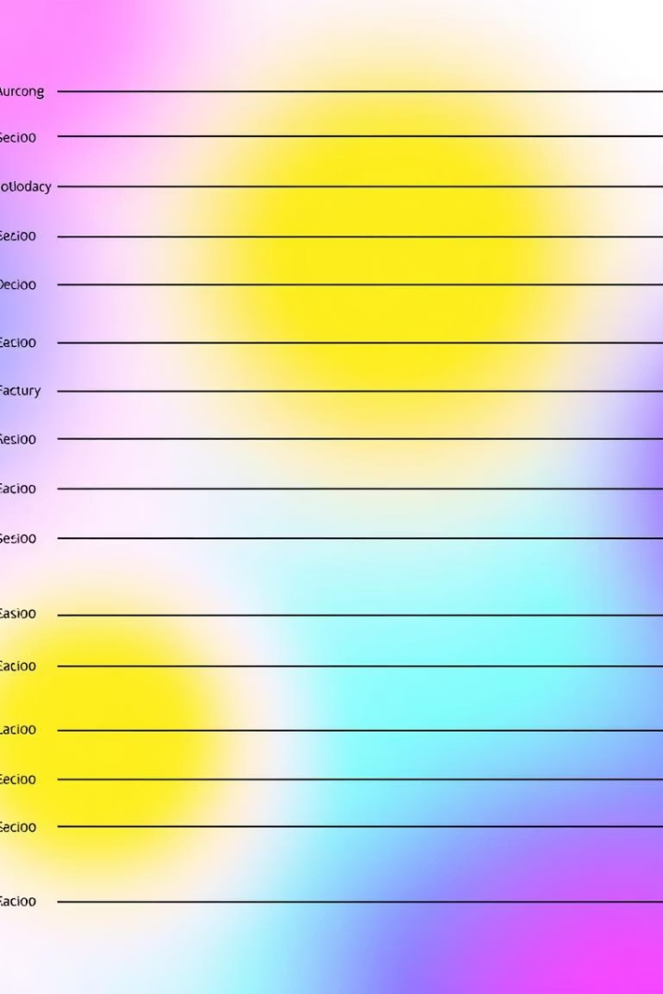
Model 2 – Classification
92%
88%
Accuracy
Precision
High precision in predicting visit modes.
Correctly identified positive predictions.
90%
Recall
Effectiveness in identifying all relevant instances.
The Classification Model uses Random Forest to predict visit modes, achieving strong performance across all key metrics.

Slide 9





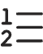
Model 3 – Recommendation System
Content-Based Filtering
Alternative based on attraction metadata.
Ranked List
Collaborative Filtering
Generates personalized attraction suggestions.
Utilizes user-attraction interaction data.

Slide 10
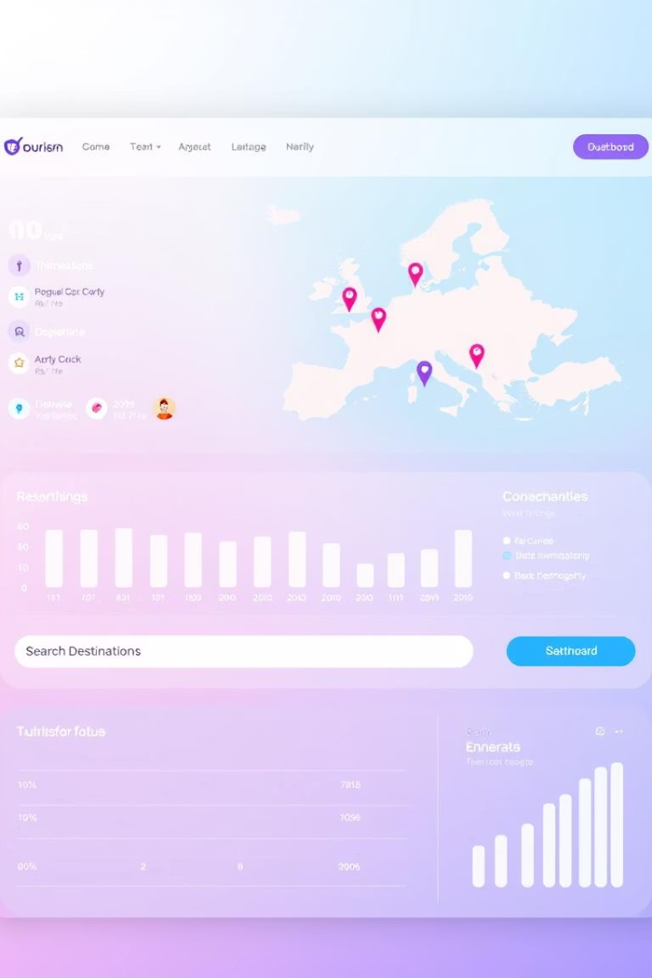




Streamlit Application
User Inputs
Predicted Visit Mode
Recommendations
Collects location and preferences.
Displays classified visit intentions.
Personalized attraction suggestions.
Visual Dashboard
Provides interactive insights.

